Slide 1
ESNCH Congress 2021
Article presentation
By Mohammad Malakooti
October 2021
Iran University of Medical sciences, Tehran, Iran

Slide 2
Title: Mesencephalic Raphe nucleus and third ventricle diameter changes in patients with non-psychotic bipolar mood disorder.

Slide 3
Introduction
Transcranial Ultrasound in psychiatric disorders: it has been recommended to examine the mesenchymal components of the brain, midbrain, and ventricles to find valuable data in neuropsychiatric disorders.
Role of Raphe nucleus along the brainstem
Bipolar mood disorders

Slide 4
Method and Materials
Out of the total of 80 participants, 27 were diagnosed with nonpsychotic type 1 bipolar disorder (B1D), and 53 were the control group.
excluding criteria:
history of organic and neurological diseases such as epilepsy, Parkinson’s and stroke, severe psychological
complications such as psychosis, active drug abuse, and all those with inappropriate temporal bone windows or unwilling to participate.

Slide 5
Method and Materials
Performing TCS
Echogenicity of Raphe: Continuous (by complete observing of the structure), Not continuous (and reduction of the Echogenicity by the disappearance of raphe margin below 50 percent), or Absent (complete disappearing of raphe structure or pinpointing of raphe nuclei ).
Diameter of the third ventricle (DTV)

Slide 6
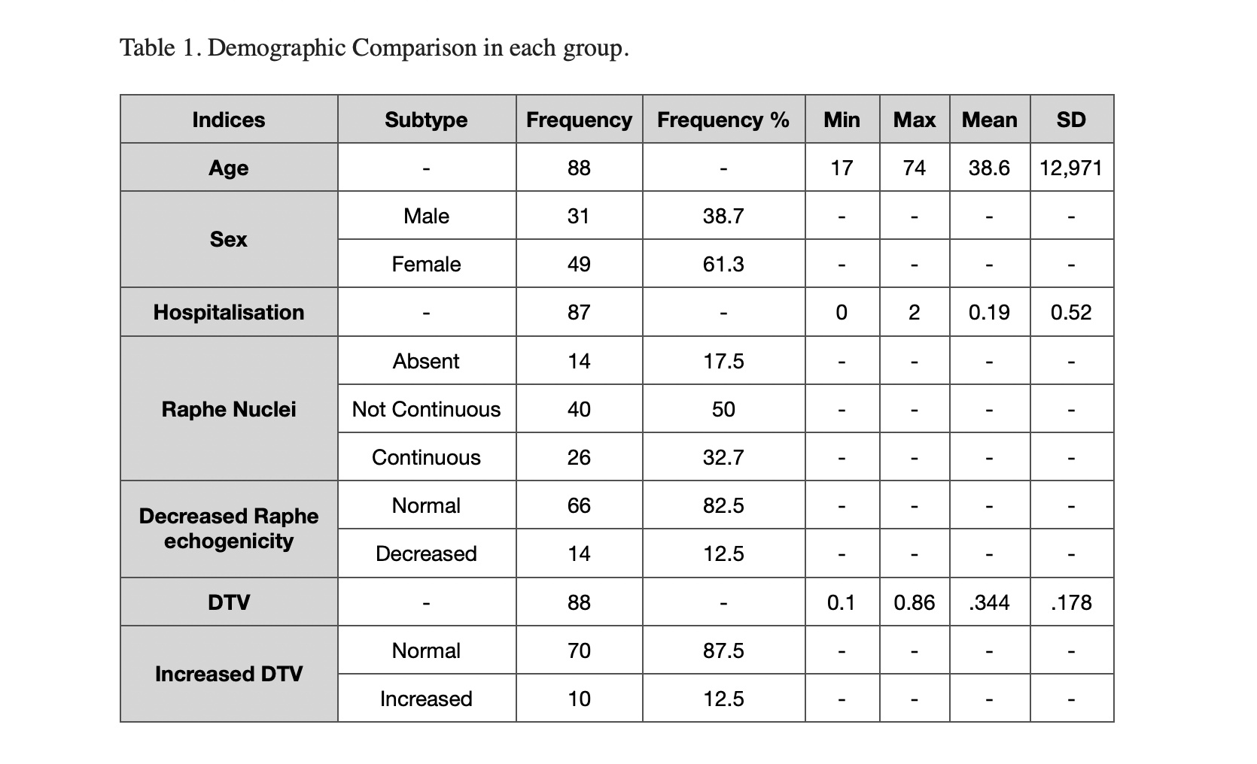
Results

Slide 7
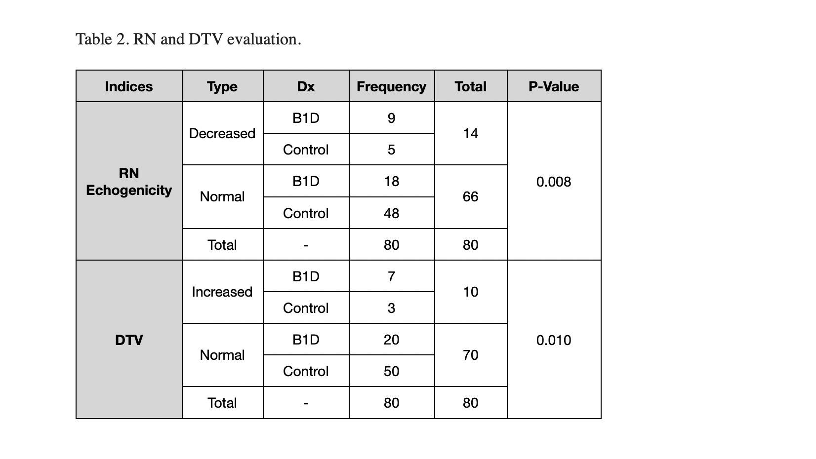
Results

Slide 8
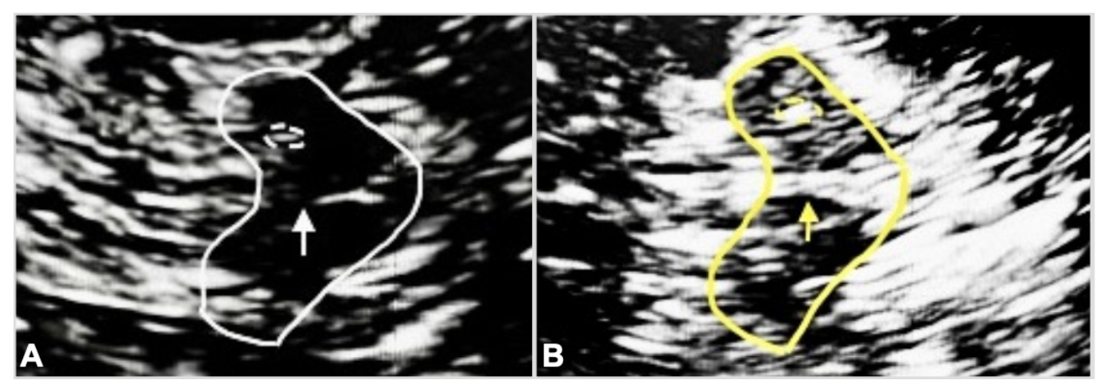
Results
A. Brainstem ultrasound view in one B1D patient, white arrow shows the absence of the raphe nucleus (disappeared line).
B. Brainstem ultrasound view in one healthy individual, yellow arrow shows intact raphe nucleus (continuous line).

Slide 9
Discussion and Conclusion
In the B1D group compared to the control group, they had a significant decrease in raphe nucleus echogenicity (p-value: 0.008)
The B1D group had a significant increase in the third ventricular Diameter (p-value: 0.01)
Transcranial ultrasound is a suitable method for analyzing mesencephalon structure in the bipolar mood disorder spectrum. In this study, Bipolar mood disorder type 1 had significantly reduced the mesencephalic raphe nucleus Echogenicity and significantly increased the Diameter of the third ventricular compared to the correlated control group.

Slide 10
Thanks for your attention!

